Slide 1
Capstone Project-2
Bike sharing demand prediction
Ratnakar

Slide 2
All about this presentation:
1. Defining problem statement. 2. Overview of data. 3. Performing exploratory data analysis. 4. Model preparation. 5. Building different models. 6. Evaluation of all models. 7. Extracting the best model

Slide 3

Problem statement
We are tasked with predicting the number of bikes rented each hour so as to make an approximate estimation of the number of bikes to be made available to the public given a particular hour of the day. It is important to make the rental bike available and accessible to the public at the right time as it lessens the waiting time. Eventually, providing the city with a stable supply of rental bikes becomes a major concern. The crucial part is the prediction of the bike count required at each hour for the stable supply of rental bikes.

Slide 4
Overview of given data
1. Date : year-month-day
2. Rented Bike count - Count of bikes rented at each hour
3. Hour - Hour of he day
4. Temperature-Temperature in Celsius
5. Humidity - %
6. Wind Speed - m/s
7. Visibility - 10m
8. Dew point temperature - Celsius
9. Solar radiation - MJ/m2
10.Rainfall - mm
11.Snowfall - cm
12.Seasons - Winter, Spring, Summer, Autumn
13.Holiday - Holiday/No holiday
14.Functional Day - No(Non Functional Hours), Yes(Functional hours)

Slide 5
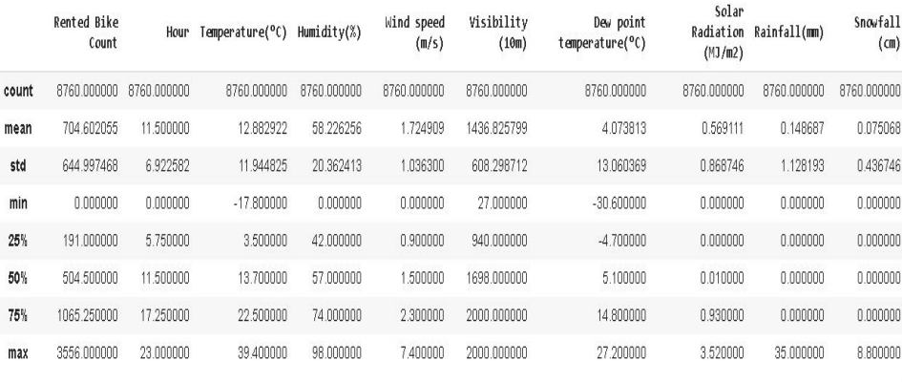
Description of data

Slide 6
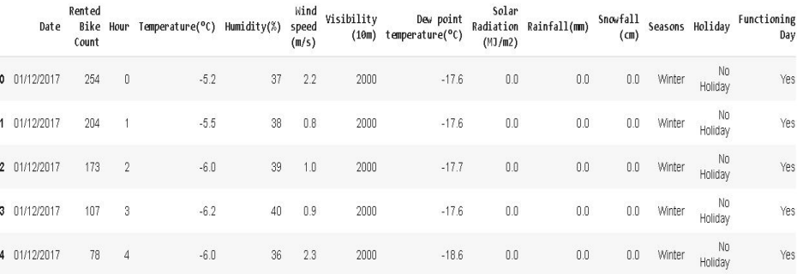
Sample of data

Slide 7
Exploratory data analysis
● Exploratory Data Analysis refers to the critical process of performing initial investigations on data so as to discover patterns, to spot anomalies, to test hypothesis and to check assumptions with the help of summary statistics and graphical representations.
● EDA is for seeing what the data can tell us beyond the formal modelling or hypothesis testing task.

Slide 8
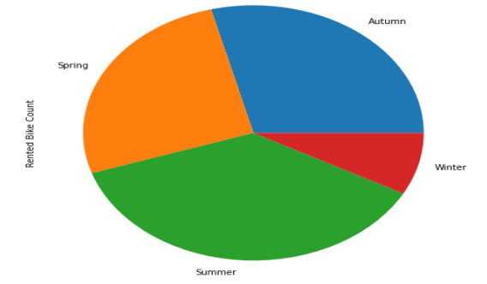
Comparison of bikes rented seasonally
conclusions from above pie chart:
1. most bikes have been rented in the summer season.
2. least bike rent count is in winter season.
3. autumn and spring seasons have almost equal amounts of bike rent count

Slide 9
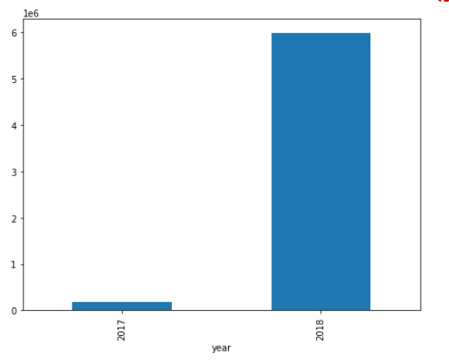
Comparison of number of bikes rented (year)
This plot shows that most of the bikes have been rented in the year 2018

Slide 10
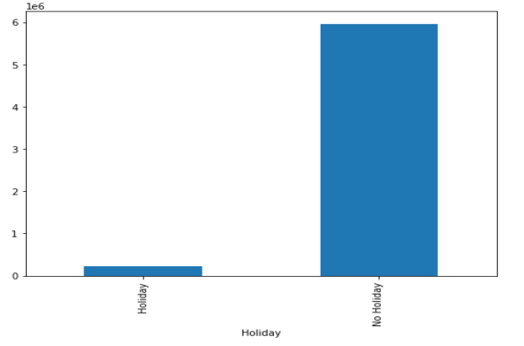
Comparison of number of bikes rented (type of day)
This plot shows that most of the bikes have been rented on working days

Slide 11
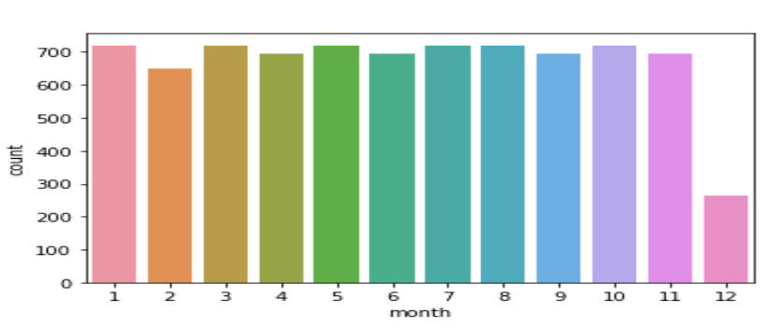
Comparison of number of bikes rented in year 2018
This plot shows that most of the bikes have been rented in December (winter)

Slide 12
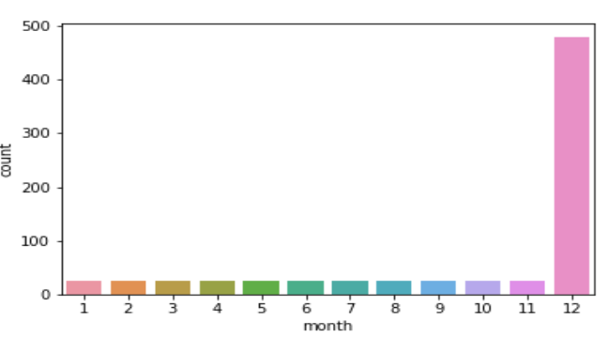
Comparison of number of bikes rented in year 2017
This plot shows that most of the bikes have been rented in December in the year 2017

Slide 13
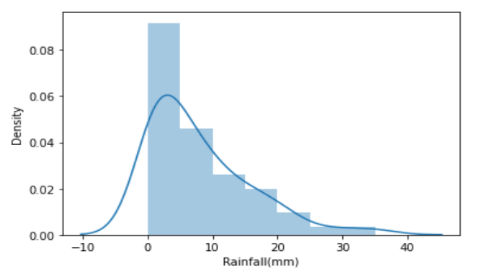
Distribution of bike rentals according to rainfall intensity
This plot shows that most people tend to rent bikes when there is no or less rainfall

Slide 14
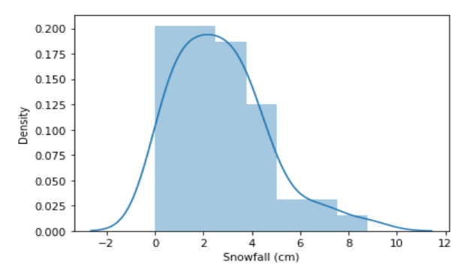
Distribution of bike rentals according to snowfall intensity
This plot shows that most people tend to rent bikes when there is no or less snowfall.

Slide 15
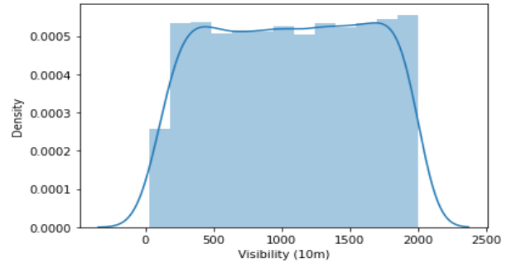
Distribution of bike rentals according to visibility
This plot shows that most people tend to rent bikes when visibility is between 300 t0 1700.

Slide 16
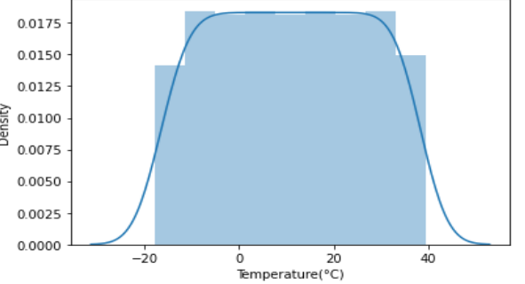
Distribution of bike rentals according to temperature intensity
This plot shows that most people tend to rent bikes when temperature is between -5 t0 25 degrees.

Slide 17
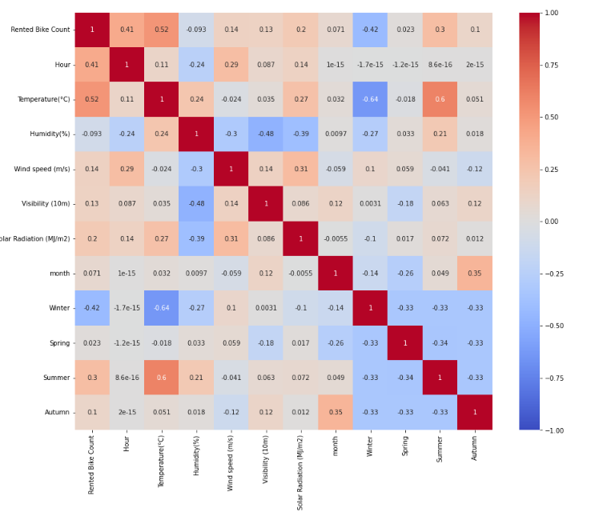
Correlation map
Heat map shows slightly positive relation of Rented bike count with Hour, Temperature, Dew point Temperature, Solar Radiation.
Bike sharing count is negatively co-related to Humidity, Snowfall, Rainfall.

Slide 18
Model preparation
1. Plotting the correlation heatmap and removing variables which are highly correlated.
2. Calculating multicollinearity through VIF and filtering our data.
3. Converting data types of variables into relevant data types.
4. Filling the null values in our data with mean of particular values.

Slide 19
Models used
Linear regression model
Lasso regression model
Ridge regression model
Decision tree regression model
Random-forest regression model
Extra-trees regression model

Slide 20
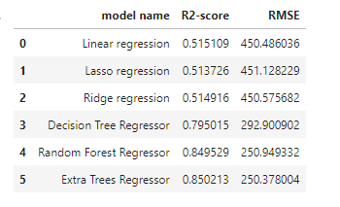
Evaluation of models

Slide 21
Conclusion
Most numbers of Bikes were rented in Summer, followed by Autumn, Spring, and Winter. May-July is the peak Bike renting Season, and Dec-Feb is the least preferred month for bike renting.
Majority of the client in the bike rental sector belongs to the Working class. This is evident from EDA analysis where bike demand is more on weekdays, working days in Seoul.
Temperature of 20-30 Degrees, evening time 4 pm- 8 pm, Humidity between 40%-60% are the most favourable parameters where the Bike demand is at its peak.
Out of all models used , with extra-trees regression model we were able to get the r2- score of 0.85.

Slide 22
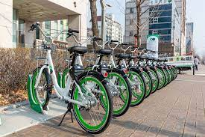
Thank you

